Slide 1
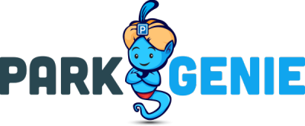
Developed By:
James Bates
Spencer Clemens (Scrum Master X2) Django, Html / Bootstrap
Nath Holst
Spencer Kasteler

Slide 2
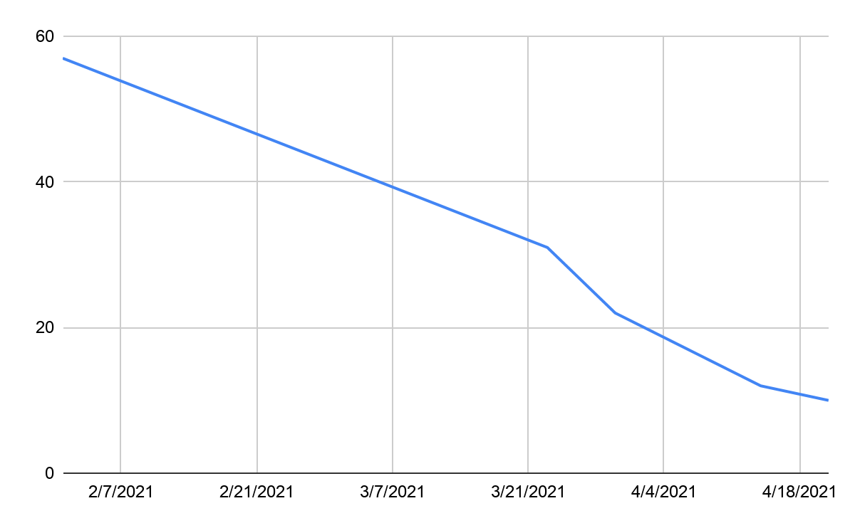
Burn Down Chart For the project

Slide 3
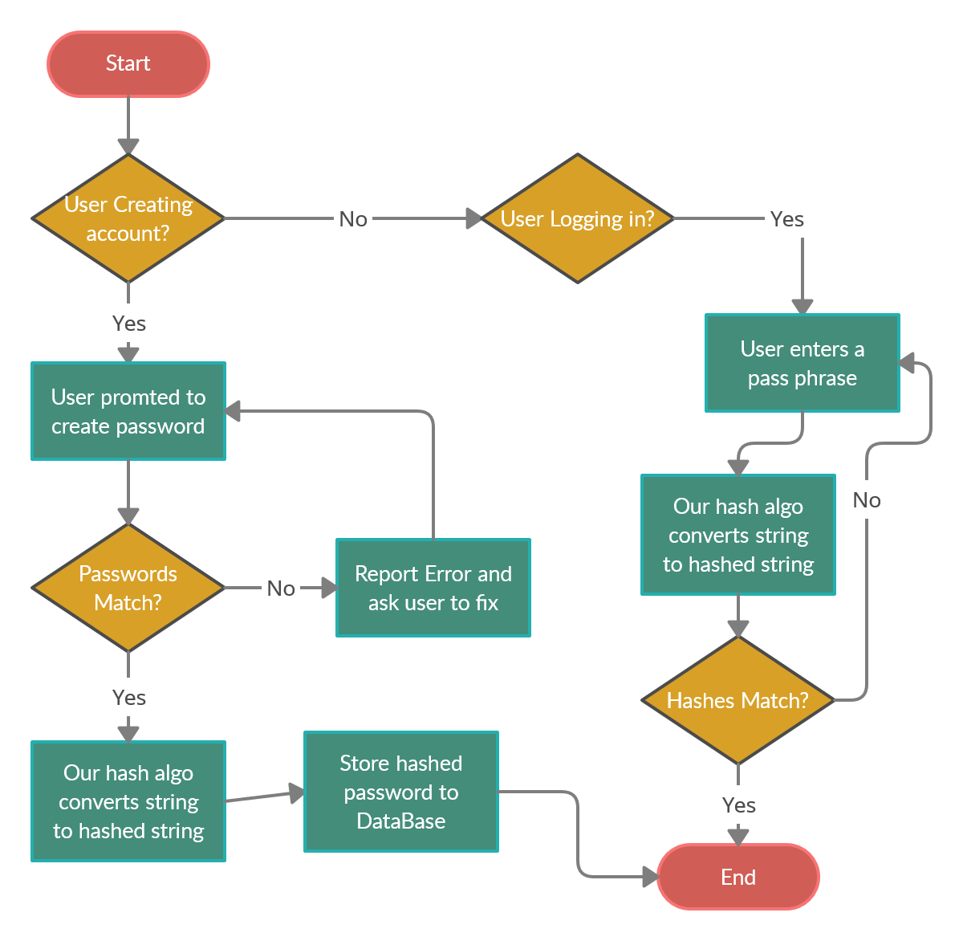
Cryptography/ Account security part 1
* for reference https://github.com/2ndPlaceBestPlace/blob/main/docs/requirementsDefinition.md
Designed by Spencer Clemens
Requirements definitions:
Account Manipulation
Back end Authentication
User Rights Authentication
Original low level design

Slide 4
Cryptography/ Account security part 2
Designed by Spencer Clemens
Functionality:
The Account security username and password system interacts with the django built in user system. The system implements Django built in session tokens and the Django login and logout system. This function allows the website to make sure a user logs in before accessing any material and can be used to
Usability:
The user does not have to worry about interacting with this system because it is all backend stuff. For those who work on the system in the future they can reference material released by Django on how to interact with the system.
Reliability:
This system is critical because it is the cornerstone of serving all user related data. However the system was only ever down due to altering the base user platform provided by Django.
Performance:
We did not do specific testing for the latency of this system but I never had a problem with having to deal with return times during testing.
Supportability:
Because this system uses the Django built in framework there are a large amount of guides on how to test the system, adapt the system, service the system, etc. The only problem comes in when something is not done exactly the way Django expects it to be done. IE if you add an attribute to the base user without also updating the settings.py folder everything will brake.

Slide 5
Cryptography/ Account security part 3
Designed by Spencer Clemens
Itemized list to get the account security working:
Create profile class extending the models.Model. IE make users more functionable.
Ensure CSRF token working properly
Implement “django.contrib.sessions.middleware.SessionMiddleware”in views.py
Create “checkedLoggedIn” function
Implement “authenticate” and “login” method in logIn method in views.
Create signals.py and add all functions needed to make it work propelrly.
Get register to work with Django. IE properly check to see if user or email is already in database

Slide 6
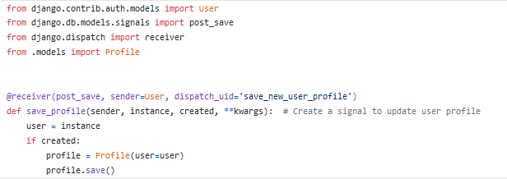
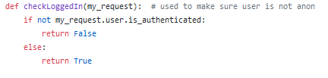
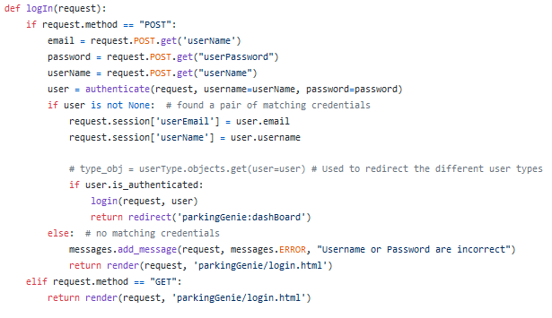
Cryptography/ Account security part 3
Code snippets:
Designed by Spencer Clemens

Slide 7

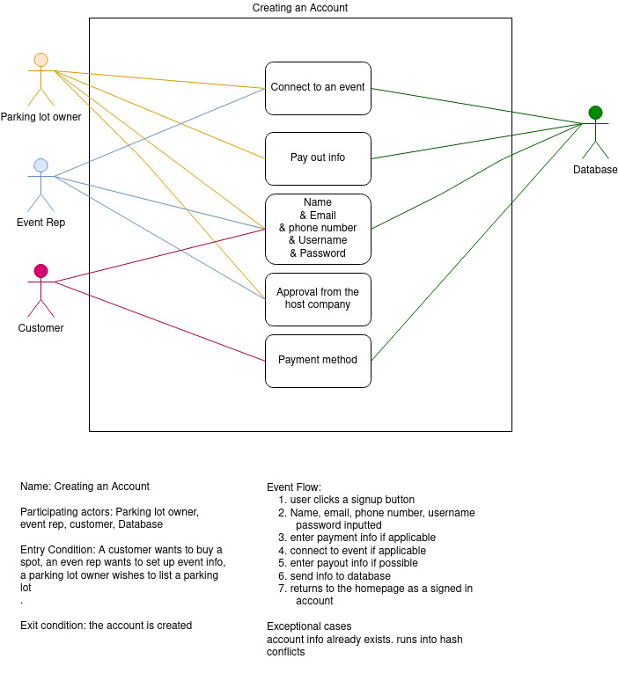
Use Case: Creating an account video/ Diagram

